Slide 1
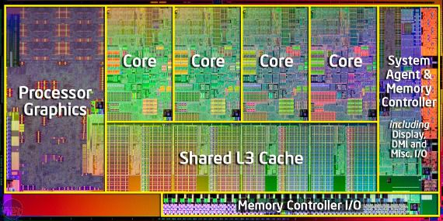
Threads (Multithreaded Programming)
Notion of a Thread
Strategies for Implicit threading
Multithreaded Models and Libraries

Slide 2
Multithreaded Programming
Single and multithreaded processes
Multicore programming
Advantages of multithreading
Multithreaded models
Multithread libraries

Slide 3
Overview
A process may contain multiple threads of control
A thread is a basic unit of CPU utilization, consisting of
A thread ID A program counter
A register set A stack
It shares all other and OS resources with the threads of the same process
A traditional process is referred to as heavyweight process
May be single-threaded or multithreaded
Motivation for multithreaded processes
Most software packages are multithreaded

Slide 4
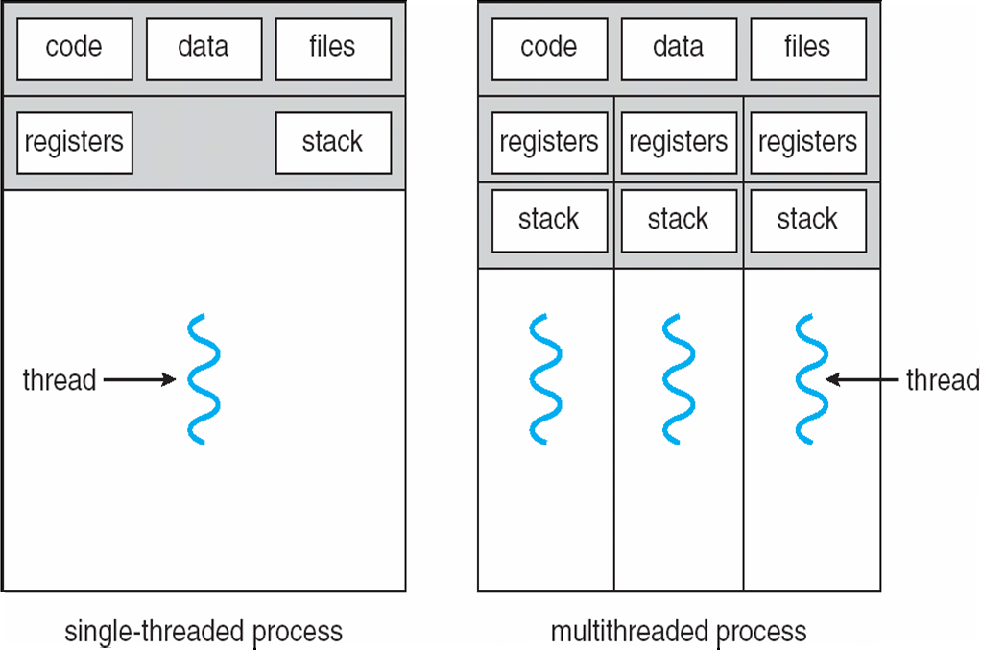
Single and Multithreaded Processes
Notes:
4

Slide 5
Motivation for Multithreaded Process
A single application may require to perform several different tasks
Create a separate process for each task
Creation of process is time consuming and is resource intensive
Create a number of threads in a single process
Interprocess communication is more efficient with multithreaded processes that are responsible for communication
Most OS kernels are multithreaded, each thread performing a specific task

Slide 6
Benefits of Multithreaded Programming
Responsiveness
Improves response time of interactive programs
Resource sharing
Threads in the same process share memory and other resources
Applications may have several different threads of activity within the same address space
Economy
More economical to create and context- switch threads in terms of time and resource
Scalability – Multithreading is more beneficial in a multiprocessor architecture
Threads of the same process can run in parallel increasing concurrency

Slide 7
Multicore Programming
Multiple computing cores are now placed on a single chip
Multiprocessor systems
Multithreaded programming is an efficient use of multiple cores
Concurrency and parallelism
Systems may be concurrent or parallel or both
A system is parallel if it can perform more than one task simultaneously
A concurrent system supports more than one task by allowing all the tasks to make progress
It is possible to have concurrency without parallelism
Multicore processors may also be multithreaded

Slide 8
Multicore Programming
Programming Challenges
Programmers are facing the challenge to modify existing programs or design new programs that are multithreaded
OS designers must write scheduling algorithms that exploit multiple cores
Five areas present challenges for multicore systems
Identifying tasks
Examine applications to find parts that can be divided into separate concurrent tasks
Balance
Tasks must perform equal work of equal value

Slide 9
Multicore Programming
Data splitting
Data to be manipulated by tasks must also be partitioned to run on separate cores
Data dependency
Data accessed by tasks must be examined for dependencies between two or more tasks
Synchronization is necessary to accommodate data dependency
Testing and debugging
It is more difficult to test and debug multithreaded concurrent programs
Parallel programming should be increasingly emphasized

Slide 10
Multicore Programming
Types of Parallelism
Data parallelism Task parallelism
Data parallelism
Focuses on distributing subsets of the same data across multiple computing cores and performing the same operation on each core
Distribution of data among multiple cores
Task parallelism
Distributing tasks across multiple cores
Each thread performs a unique operation
Different threads may be operating on the same or different data
Distribution of tasks across multiple cores
Applications use a hybrid of the above two strategies

Slide 11
Multithreading Models
Support for threads may be at the user level or kernel level
User threads are managed without kernel support
There must exist a relationship between user and kernel threads
Many-to-One Model
Maps many user-level threads to one kernel thread
Thread management is done by the thread library in user space
Entire process blocks if a thread makes a blocking system call
Multiple threads are unable to run in parallel in multiprocessors

Slide 12
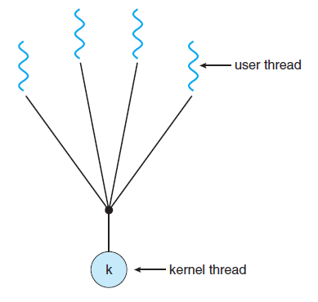
Many-to-One Model
Notes:
12

Slide 13
Multithreading Models
One-to-One Model
Maps each user thread to one kernel thread
Allows more concurrency than many-to-one model
Allows another thread to run in case of a blocking system call
Allows parallel execution in multiprocessors
Creating a user level thread requires creating a kernel-level thread
Number of threads are restricted
Many-to-Many Model
Multiplexes many user-level threads on a smaller or equal number of kernel-level threads

Slide 14
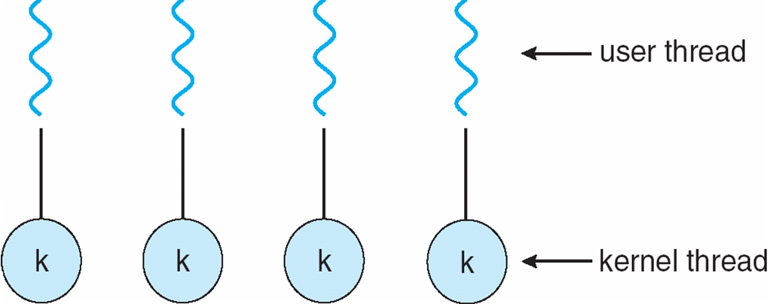
One-to-one Model
Notes:
14

Slide 15
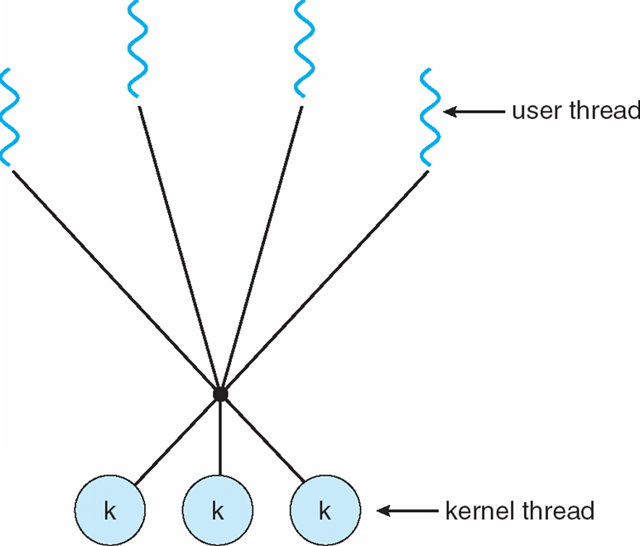
Many-to-Many Model
Notes:
15

Slide 16
Multithreading Models
Shortcomings of the previous two models are not there
Developers can create as many user threads as necessary
Kernel threads can run in parallel in multiprocessors
In case of a blocking system call, kernel can schedule another thread
The two-level model
A variant of many-to-many model
Allows a user-level thread to be bound to a kernel thread

Slide 17
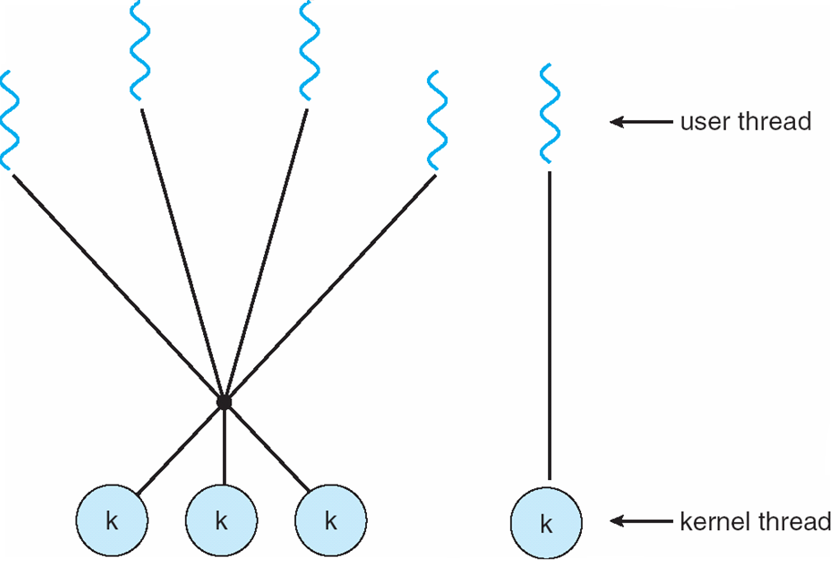
Two-level Model
Notes:
17

Slide 18
Thread Libraries
Provides the programmer an API for creating and managing threads
There are two approaches for implementing thread library
Provide a library in user space without any kernel support
Local function call in user space
Implement a kernel-level library supported directly by the OS
Invoking a library function results in a system call to the kernel
Three commonly used thread libraries
POSIX Pthreads, Win32 and Java

Slide 19
Memory Management
Part 3
Memory Management Strategies
Virtual Memory Management

Slide 20
Memory Management
All programs and data must be in main memory before execution
Partially or completely
Several processes are in main memory to
Improve CPU utilization
Improve speed of response to the users
Memory management schemes help achieve these objectives
Hardware specifications/ design determine the selection option for a particular memory management scheme

Slide 21

Memory Management Strategies
Ways to manage memory
Hardware support
Logical and Physical address Space
Swapping
Memory allocation to processes
Contiguous memory allocation
Fragmented memory allocation
Segmentation
Paging
Hardware support for paging and segmentation
Shared fragments
Example of Intel 32 and 64 bit architectures

Slide 22
Introduction
Share memory among a number of processes
Various ways of organizing memory hardware
A number of ways exist to manage memory
From bare machine approach to paging and segmentation techniques
Each approach have their advantages and disadvantages
Hardware support is required to support a management technique
Integration of hardware and operating system

Slide 23
Background
Memory is central to the operation of computer systems
CPU fetches instructions from memory using address in the program counter
Decode the instruction
May require operand fetch from memory
Execute the operation
Result may be stored back in memory
Memory sees a stream of addresses
Techniques for managing memory
Basic hardware issues
Binding symbolic to physical addresses
Distinguish between logical and physical address
Dynamic linking and shared libraries

Slide 24
Basic Hardware
CPU accesses all data and instructions directly from main memory
Access to registers, instruction decoding and operations of simple instructions can be performed within a cycle of CPU
Main memory is accessed via a bus transaction taking many CPU clock cycles
This may require the CPU to stall
Solution is to add a fast memory, a cache, between the CPU and main memory
Correct operation of OS requires its protection from user processes
User processes must also be protected from each other
This protection is provided through hardware

Slide 25
Basic Hardware
Each process should be allowed to access only its legal addresses
Use two registers
Base and limit registers
Base register holds the smallest legal physical memory address
Limit register specifies the size of the range
Every generated address is compared to determine its legality
An attempt to violate the legality results in a trap to the OS-treats it as a fatal error
Base and limit registers can be loaded only by OS using privileged instructions executed in kernel mode

Slide 26
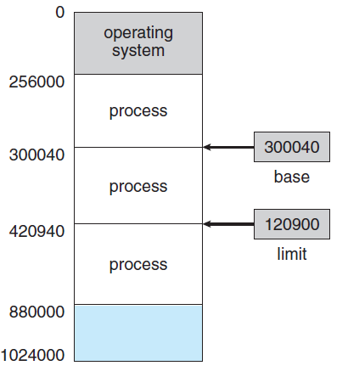
Base and Limit Registers
Notes:
26

Slide 27
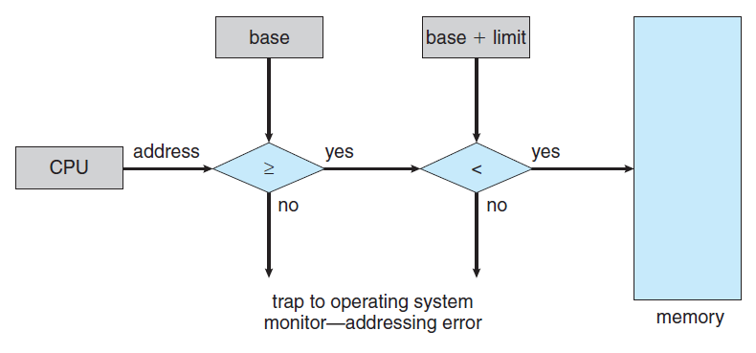
HW address protection with base and limit registers

Slide 28
Address Binding
Processes waiting on a disk to be brought into memory form the input queue
The process is loaded in any part of the memory that is made available to it
Ways of representing addresses during the steps involved
Compiler binds the symbolic addresses in the source program to relocatable addresses
Linkage editor or loader binds the relocatable addresses to absolute addresses
Each binding is a mapping from one address space to another
Binding of instructions and data to memory addresses can be done in any of the steps

Slide 29
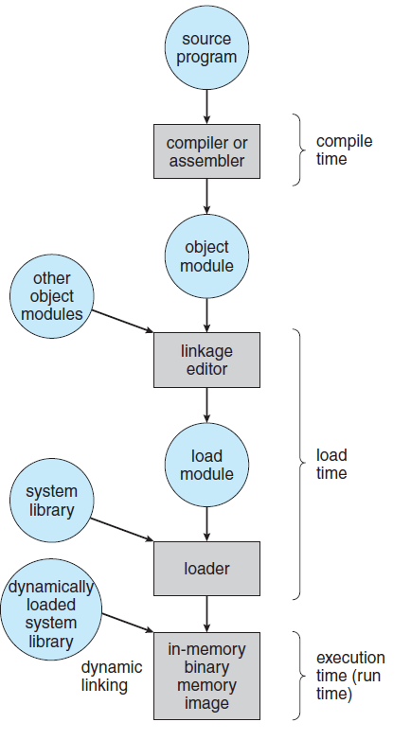
Multistep Processing of a User Program

Slide 30
Address Binding
Compile time
Absolute code is generated at compile time if it is known where the process will reside in memory
If starting address changes, recompilation is required
MS-DOS .COM-format programs
Load time
If the address is not known at compile time, the compiler generates relocatable code
Final binding is done at load time
If starting address changes, reload the user code
Execution time
If the process can be moved during execution, binding is delayed until run time
Most general purpose OS use this method

Slide 31
Logical Versus Physical Address Space
Address generated by the CPU is referred to as a logical address
Address seen by the memory unit is referred to as a physical address
Compile and load-time address bindings generate identical logical and physical addresses
Execution-time address-binding scheme results in different logical and physical addresses
Logical address is referred to as virtual address
Logical and physical address spaces
Memory management unit (MMU) does the run-time mapping from virtual to physical addresses
Generalization of base-register scheme
Notes:
Now the base register is called relocation register

Slide 32
Logical Versus Physical Address Space
Relocation register contents are added to every address generated by the CPU
User program never sees the real physical addresses
Deals with logical addresses only
Hardware is required to do the mapping
Two address ranges are involved
Logical address space
Range is 0 to max
Physical address space
Range is R+0 to R+max for a base value of R
The concept of logical address space that is bound to a separate physical address space is central to proper memory management

Slide 33
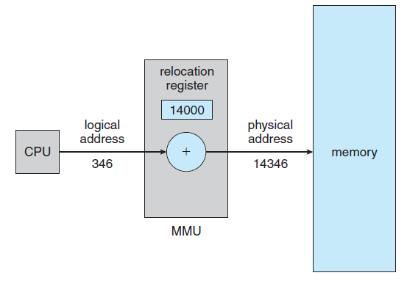
Dynamic relocation using a relocation register

Slide 34
Dynamic Loading
Size of a process in execution is limited to the size of the physical memory
Dynamic loading allows better memory- space utilization
A routine is loaded only when it is referenced
An unused routine is never loaded
Useful for applications that has a large code to handle infrequently occurring cases
Dynamic loading does not require special support from the operating system
Users are responsible to design their programs accordingly
OS may provide support in the form of library routines to implement dynamic loading

Slide 35
Dynamic Linking and Shared Libraries
Similar to the concept of dynamic loading
Linking is postponed till the execution time
Used for linking system libraries
Without this facility, each program would include an image of language library
Wastage of disk and memory space
A stub is included in the image for each library-routine reference
A small piece of code
Shared libraries
Dynamic linking requires help from the OS

Slide 36
Swapping
A process can be swapped out of the memory to a backing store temporarily
It can be later brought back into memory for continued execution
Possible for the total physical address space for all processes to exceed the physical memory of the system
Increase the degree of multiprogramming
Swapping involves moving processes between memory and a backing store which is a fast disk

Slide 37
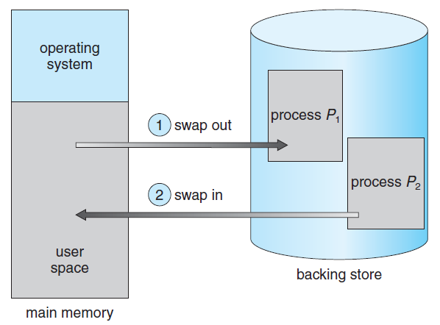
Swapping of Two Processes using a Disk as the Backing Store

